Slide 1
Pneumonia Detection using CNN
Kunal Inglunkar

Slide 2
Introduction
Pneumonia is an inflammatory condition of the lung affecting primarily the small air sacs known as alveoli.
Pneumonia is a critical medical condition with far-reaching consequences.
Efficient detection is vital for early treatment and reducing mortality.
Diagnosis is often based on symptoms and physical examination. Chest X-ray may help confirm the diagnosis

Slide 3
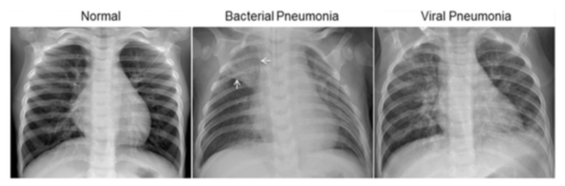
The normal chest X-ray (left panel) depicts clear lungs without any areas of abnormal opacification in the image. Bacterial pneumonia (middle) typically exhibits a focal lobar consolidation, in this case in the right upper lobe (white arrows), whereas viral pneumonia (right) manifests with a more diffuse ‘‘interstitial’’ pattern in both lungs.
http://www.cell.com/cell/fulltext/S0092-8674(18)30154-5

Slide 4
Data Set
5,863 Chest X-Ray images
Organized into 3 folders: Train, Test, Val
2 Categories: Pneumonia/Normal
Data Source: https://data.mendeley.com/datasets/rscbjbr9sj/2

Slide 5
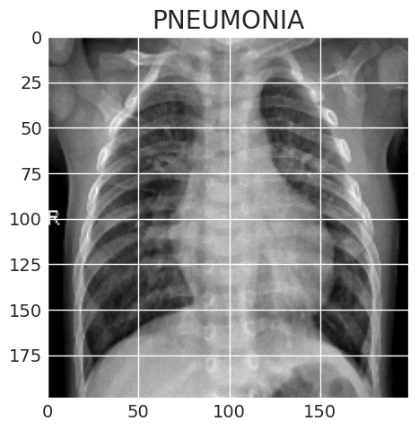
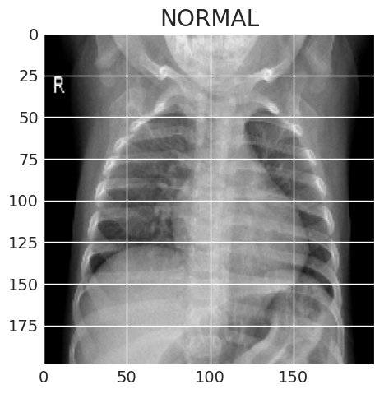
Images of both classes

Slide 6
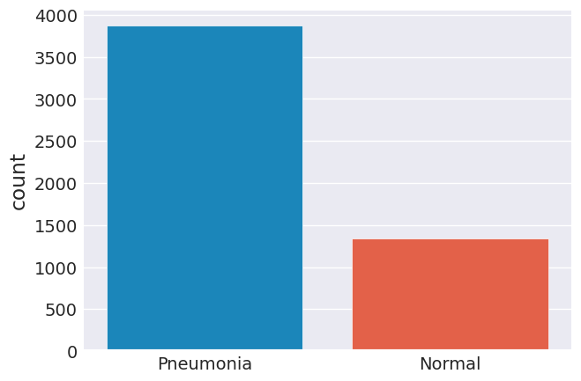
Data Visualization
The data seems imbalanced. To increase the no. of training examples, data augmentation was used

Slide 7
Data Augmentation
In order to avoid the overfitting problem, expand the dataset
The idea is to alter the training data with small transformations to reproduce the variations.
Augmentations used were:
Rotate a few training images at random by thirty degrees.
Randomly enlarge training images by 20%
Images can be shifted horizontally at random by 10% of their width.
Slide pictures vertically at random, ten percent of their height
Flip images horizontally at random. After the model is prepared, the training dataset is fitted.

Slide 8
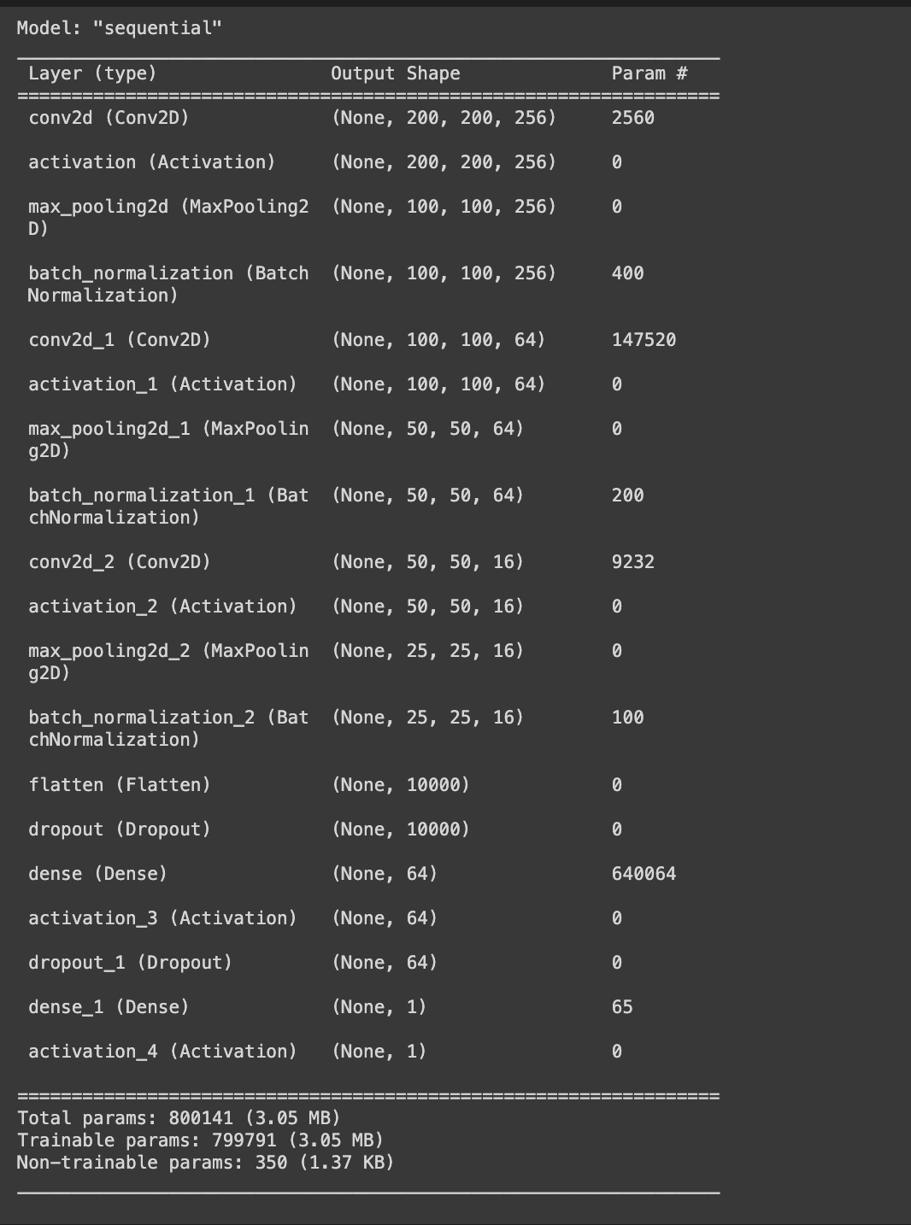
Training model

Slide 9
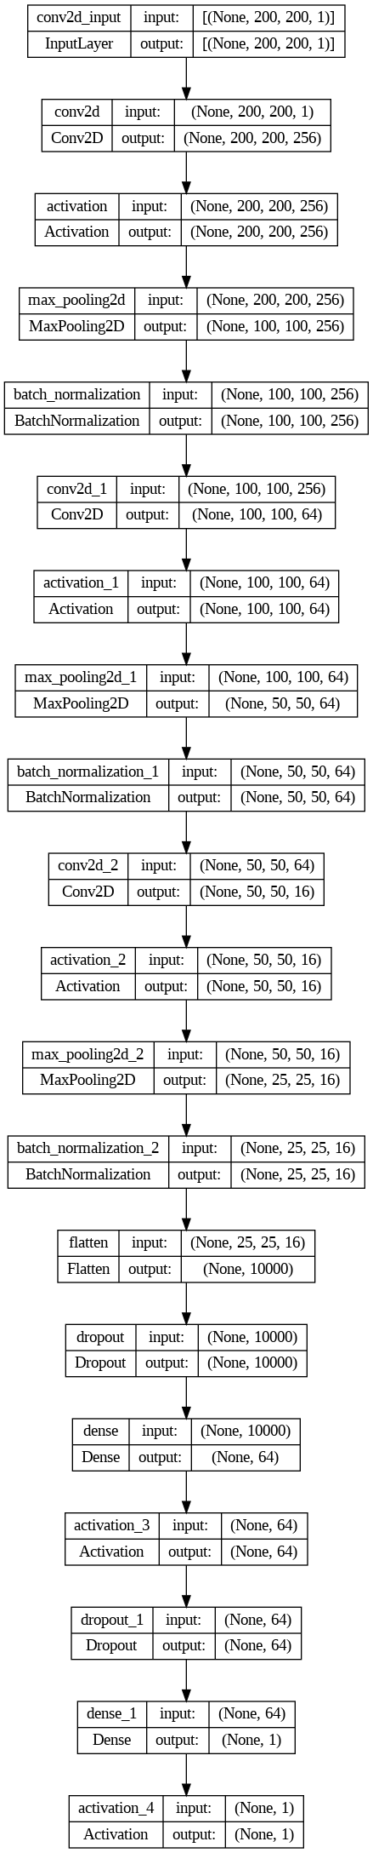
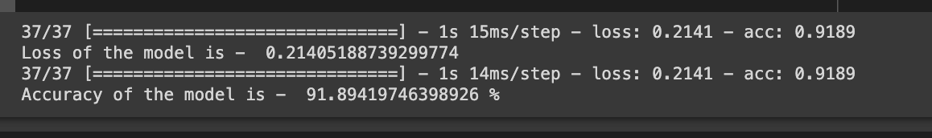

Slide 10
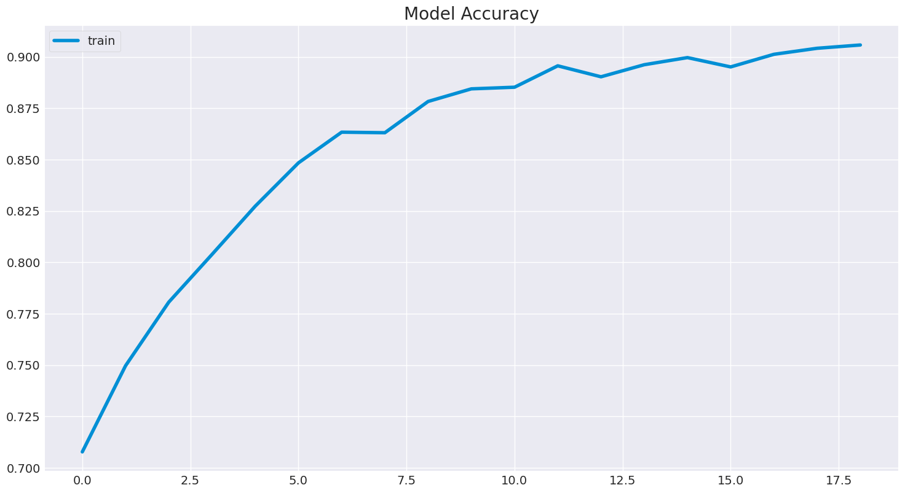
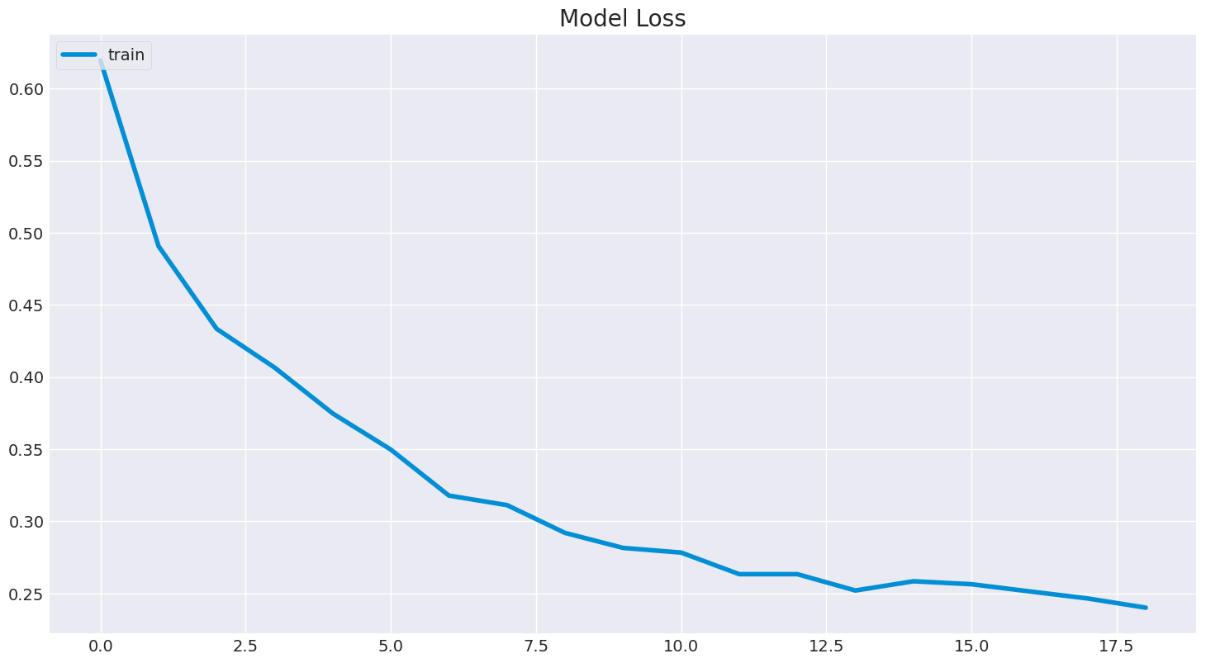
Analysis after Model Training

Slide 11
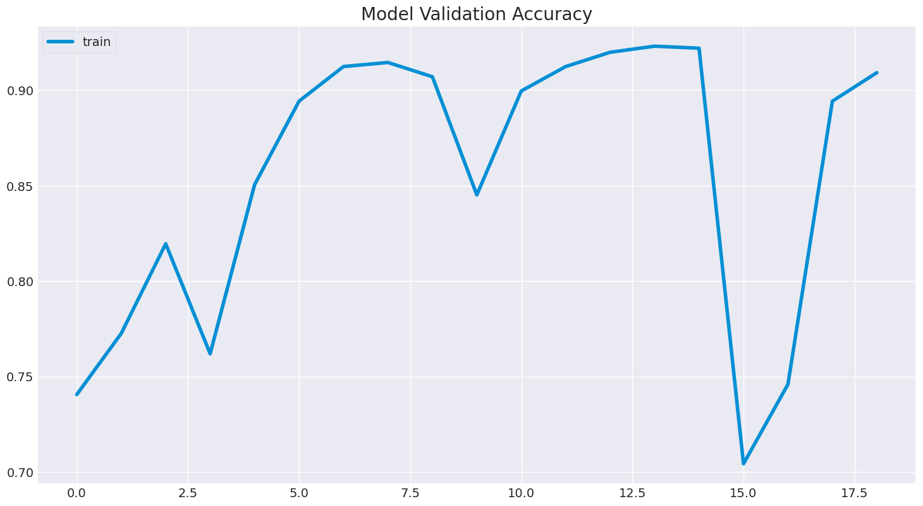
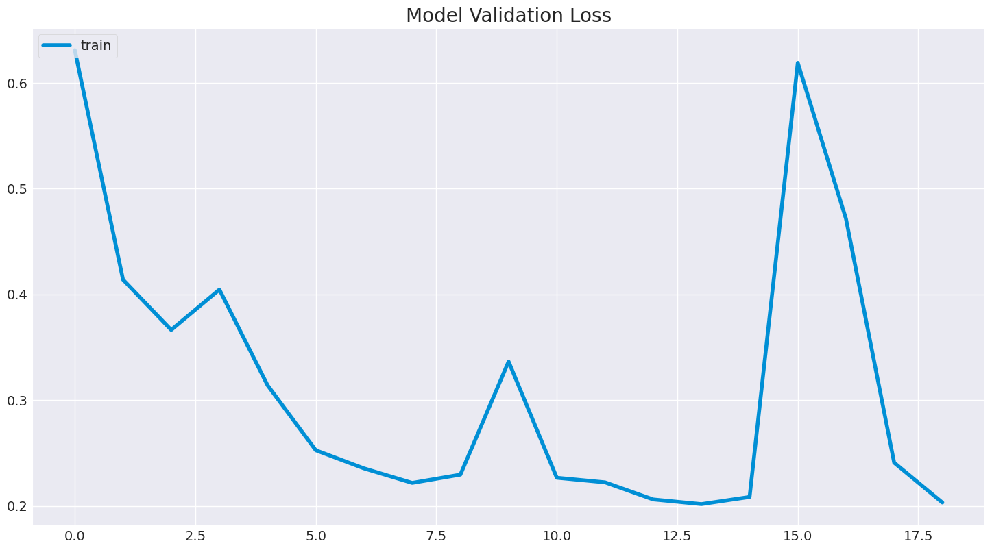

Slide 12
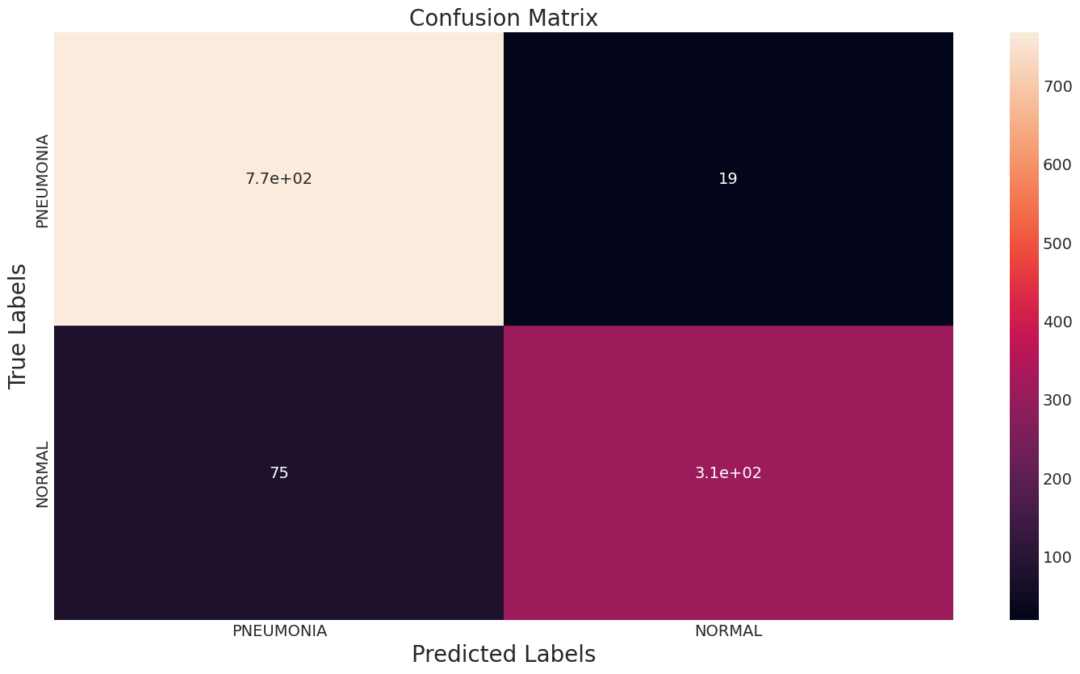
Accuracy on testing set: 0.9197952218430034
Precision on testing set: 0.9422492401215805
Recall on testing set: 0.8051948051948052
F1 score on testing set 0.8683473389355743

Slide 13
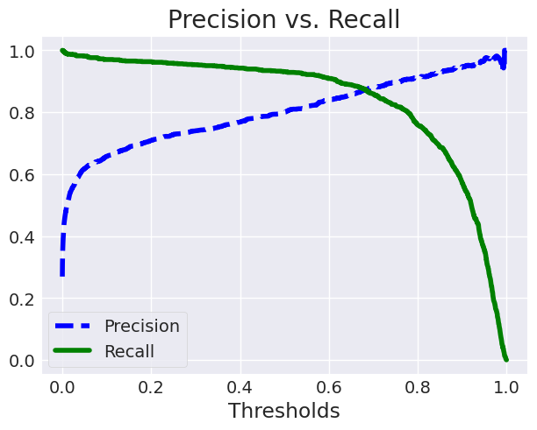

Slide 14
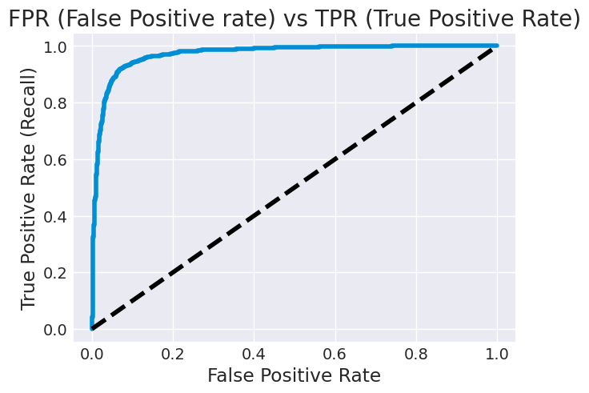

Slide 15
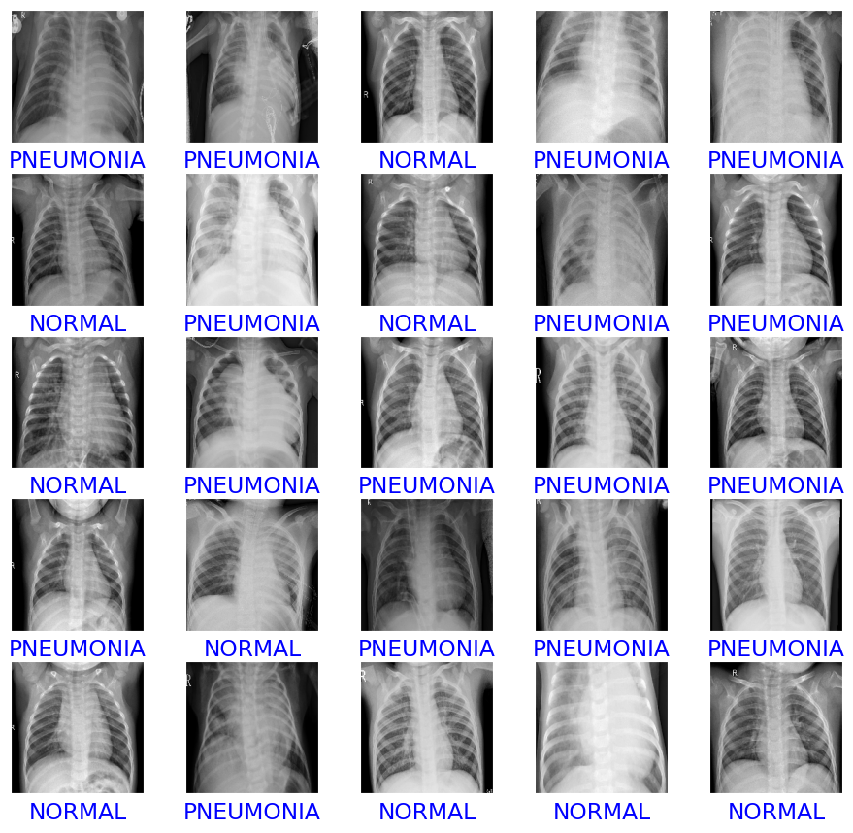
Some of the Correctly Predicted Classes

Slide 16
Source Code
https://github.com/Kunal-Inglunkar/Pneumonia-Detection-using-CNN

Slide 17
Questions

